Slide 1


R&D Sensory
User Experience (UX) Analytics.

Slide 2
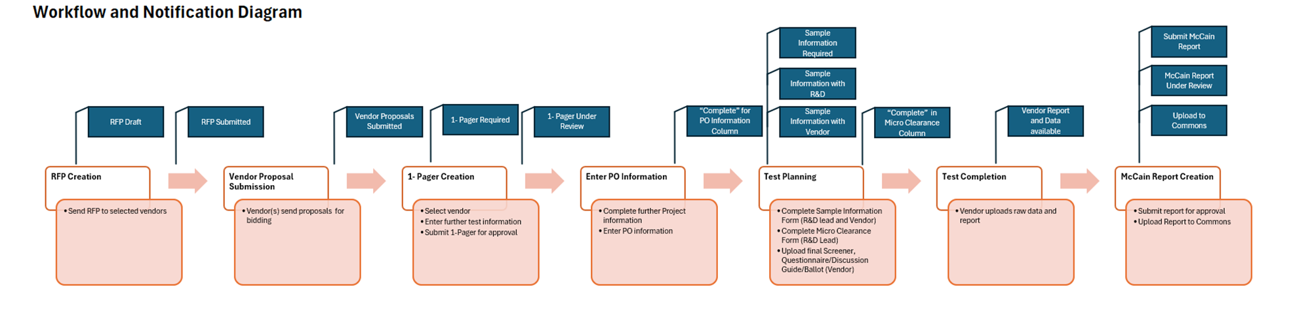




Project Details
We initiated the R&D Data Analytics project to develop a system enabler to empower R&D Sensory User Experience (UX) and Analytical and Data Science (ADS) team to drive data-led product and consumer insights with efficiency and accuracy.
Business needs
Why do we need a system tool for R&D Sensory UX data
Easy access to historical data
To know what tests have been done
Leverage existing knowledge to avoid redundant work or overwork
Data integration readily available
Extract trends across reports and regions
Understand total user experience
Robust analysis based on complete data
Future predictive analytics using AI built on solid data foundation when test data integrated with product recipe and quality data
Automated process from test creation to completion
System Objective
What does the system do
Automate Sensory & Analytical test creation process for the SensoryUX and ADS team, consolidate test data into a structured database and use PowerBI dashboards to drive product insights
Data Scope
Tests:
Sensory UX: Quantitative consumer and descriptive
ADS: Analytical
Data captured:
Test Background
Test results
Limited product info
Sample prep (cooking + holding)
Notes:
Additional Details

Slide 3
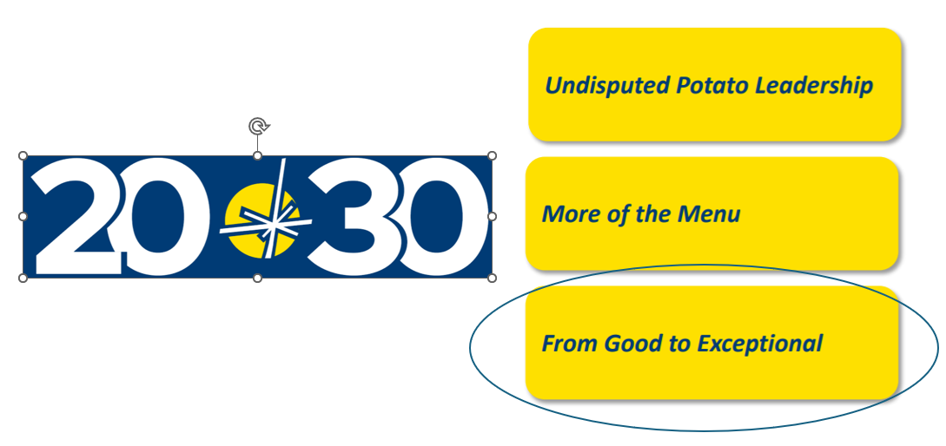
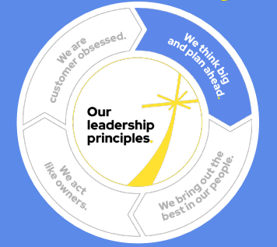
F30 Alignment
From Good to Exceptional.
Standardizing and centralizing inputs from quantitative external consumer panels and sensory tests streamlines development and business impact of McCain’s R&D Sensory UX reports. This process enables us to gather comprehensive product trends and total user experience insights that were previously difficult to access. Consequently, accelerates R&D project turnaround times, enabling us to meet market demands faster and enhance our competitive edge.
By automating data transformation and mapping for consumer and descriptive tests, we not only increase efficiency and accuracy in data management but also enable more agile decision-making. This process reduces manual errors and ensures consistency across datasets.

Slide 4
R&D Sensory UX Analytics.
Enables efficient workflow for consumer and sensory product tests and additional utilization of existing data.
Focus | What is the insight? | What action is enabled? | What value is created?*
Test Process Efficiency | How can we standardize the way the Sensory UX team executes tests to improve overall productivity? | Central platform for team to manage tests, communications, and collect/transform data for future “always on” analyses. Automated process from test creation to completion. | The total time saving across all users ranges from 110 hours saved per week. Annualized, this is 5280hrs/year saved or 2.75 FTE
Innovation Project Portfolio | What products have we tested previously and what data was collected? How can we enable analytics to enhance decision-making, improve productivity, and maintain quality standards? | Structured database enables BI reporting, giving Sensory UX team clear visibility to avoid duplicated/repetitive tests. Trends across studies and regions become available as all study materials are easily accessible through the platform. | With an annual testing budget of $3.5 million, it is estimated that $350-525k CAD (10-15%) of the funds can be conserved through effective test avoidance strategies and reallocated to other critical testing needs.
*These are time and cost-saving estimates provided by Sensory Director and team

Slide 5




Data management (collection, transformation, storage, analysis) is inefficient.
Summary
The process for the team to capture and manage product sample information and test data both internally and from external 3rd-party agencies has limitations due to:
Poor visibility to historic data
Lack of easy access to historical data and data integration, leads to redundant work, missed trends, and an incomplete understanding of user experience.
Many Manual Steps
Numerous processes, such as test approvals, data transformation, and file sharing, are cumbersome and require significant time from stakeholders involved.
Lack of Integration with 3rd Party Vendors
Collaboration with 3rd Party vendors is primarily conducted via email, to which it is slow, prone to information loss, and lacks efficiency.
To resolve this, we are building a central platform for Sensory UX team and 3rd party vendors to collaborate on test execution, data collection and management.
The opportunity: This platform will support the workflows for ~70 team members today across Sensory UX, R&D and 3rD Party Vendors, with the ability to expand to additional users in the future.

